Slide 1
Unfair Digital Marketplaces and Barriers to eCommerce
Marcel Mizzi
Vice President GRTU (Malta Chamber of SMEs)
March 2018

Slide 2
Barriers to eCommerce
Seller’s perspective.
#BetterDigitalWorld

Slide 3
Lack of knowledge
Lack of knowledge is the biggest hurdle,
Many business owners do not buy goods or services online themselves and therefore think that it is not important.
In some sectors employees lack knowledge as well.
Although maintaining an eCommerce platform is not very technical it does require some training.
Many business owners are ignorant of schemes by Government and social partners that are designed to assist them.
#BetterDigitalWorld

Slide 4
Lack of knowledge – Using the medium
Lack of knowledge also plays a part in how online vendors display their products.
Many do not understand that on the Internet, products should be marketed by using the medium in creative ways.
Digital marketing is far superior to traditional marketing.
Many display products lacking in detail and do not make use of the tools available to enhance the online shopping experience.
Vendors who have grasped this idea are therefore at a considerable advantage.
#BetterDigitalWorld

Slide 5
Lack of knowledge – Holistic Digital Identity
Online sellers need to be aware that simply creating an online store is not enough.
Online businesses need to create a holistic digital identity by :
Monitoring website use and targeting marketing appropriately.
Creating their business profile on Social Media.
Marketing (Pay per click/view) on Social Media.
Encouraging peer reviews (rather than the opposite)
Allocate human resources to answer online customer queries and handle customer complaints.
Maintain a consistent brand Identity to encourage brand loyalty.
#BetterDigitalWorld

Slide 6
Lack of knowledge
As discussed, being aware is very important.
Online (and offline) sellers should be members of organisations such as GRTU to be kept informed.
It is a pity to see many SMEs unaware of many Government initiatives designed to encourage them to sell online.
Organisations like GRTU need feedback from online sellers which we then use to maintain our policies.
#BetterDigitalWorld

Slide 7
Lack of resources
With over 90% of businesses in the EU being micros, lack of human resources can be a major issue.
In micro businesses two or three employees do everything. Many times maintaining an eCommerce site is not a priority.
Today with the current “Full employment” scenario this has become much more pronounced.
GRTU together with MCA have been active on this issue by creating tools such as Blink – Online directory of service providers.
#BetterDigitalWorld

Slide 8
Lack of funds
Unfortunately many retailers are happy investing thousands in brick and mortar shops but not on eCommerce.
Many are unaware of schemes such as “e-Commerce Grant Scheme - Business Enhance ERDF”
Banks are reluctant to finance startup web projects in spite of instruments such as Jeremie and Jamie schemes.
#BetterDigitalWorld

Slide 9
Relevance
Many SMEs claim that eCommerce is not relevant for their business.
This is often an excuse and it is their lack of knowledge that drives them to claim this.
Some businesses really cannot sell their products or services online but they can still use the Digital Marketing which is far superior to traditional marketing.
Again, knowledge is key.
#BetterDigitalWorld

Slide 10
Not having competitive prices
Even today, many Maltese businesses do not want to show their product prices online !
They claim that competitors will lower their prices to match theirs.
They also claim that they simply cannot match online pricing.
With this reasoning there might as well be one seller of a particular product on eBay. This is of course untrue!
#BetterDigitalWorld

Slide 11
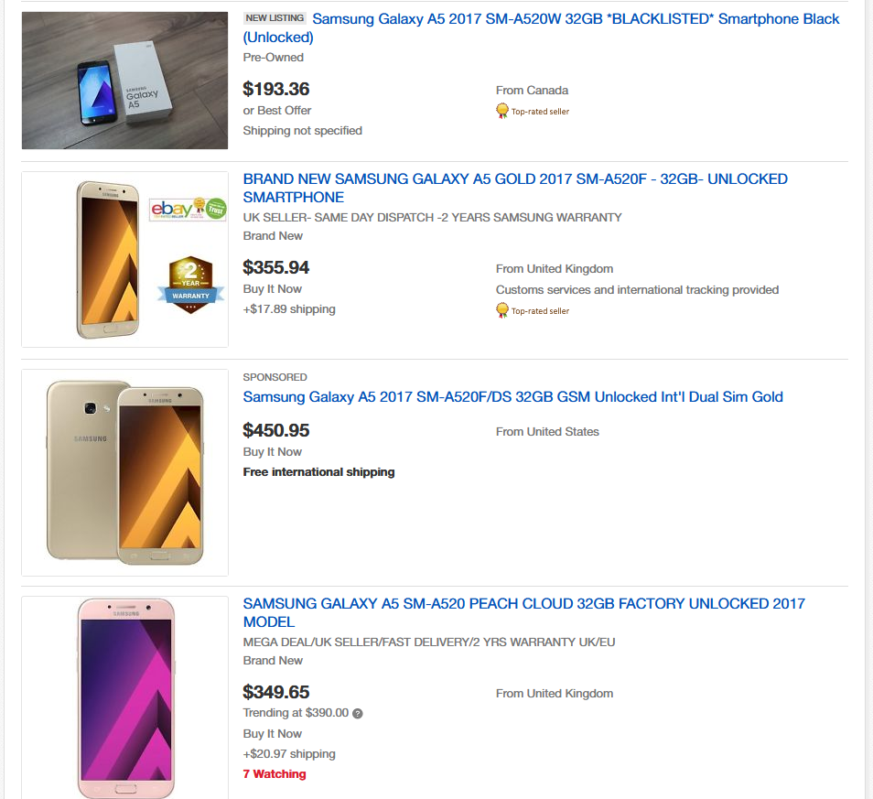

Slide 12
Logistics
Some business claim that they cannot deliver products, even to Malta.
Today inexpensive courier services exist (Malta to Malta)
Cross border selling to other EU countries is still problematic. Freight costs vary illogically. Impossible to compete with low cost products from Malta.
China, Hong Kong have solved this issue and are winning online. More on this later.
#BetterDigitalWorld

Slide 13
Unfair trading
A major problem even in Malta.
Illegitimate sellers not registered with VAT or IRD openly sell products online and undercut registered businesses.
This is also a problem for traditional offline sales but going digital has exasperated it.
Illegitimate sellers do not :
Pay VAT or income tax.
Pay environmental taxes.
Uphold warranty agreements.
Uphold consumer rights and offer redress mechanisms.
#BetterDigitalWorld

Slide 14
Language barriers
Very significant in cross border trading.
Although in many countries English is spoken widely, natives still prefer to be addressed in their own language.
Adds the costs involved in hiring translators.
Makes ongoing website maintenance more expensive.
Sellers seriously marketing in another EU country may have to employ native speakers to be able to communicate with clients pre and post sale.
#BetterDigitalWorld

Slide 15
Regulatory barriers and market fragmentation.
Different VAT rates in different EU countries.
The problem of having to register for VAT in several countries and submit regular VAT returns.
The VAT MOSS (Mini One Stop Shop) was designed to solve this issue but for now still applicable only to services.
The eInvoicing directive will also help in this regard when it is eventually enacted.
#BetterDigitalWorld

Slide 16
Regulatory barriers and market fragmentation.
Different consumer regulations (Especially non EU)
Different intellectual property protection regulations.
Different national transposition of the EU legislation on electronic waste disposal (WEEE) and the Packaging Directive.
This considerably diminishes the appeal or feasibility of cross-border expansion. As a result, traders may refuse to serve new markets or may develop online business models that fragment the internal market along national lines.
#BetterDigitalWorld

Slide 17
Payment systems
Fear of fraud and non-payment (Many SME’s claim not to be selling online because of perceived risk of card fraud)
High costs of payment processing. Paypal, while very safe for the consumer is very costly for the seller. Impossible to maintain competitive prices on low profit products.
High costs of implementing local payment gateways which are also not trusted by the consumer.
#BetterDigitalWorld

Slide 18
Online malls. A solution ?
Advantage of sharing logistics costs
Advantage of sharing payment gateways.
Unfortunately create another “Middle-man” who invariably takes a cut of their profits.
Traditionally businesses do not like to be grouped together.
They prefer to market their products or services separately for fear of encouraging sales from their competition.
In Malta, many have tried and failed.
#BetterDigitalWorld

Slide 19
What about sellers outside the EU such as China ?
They do not abide by EU regulations.
They are increasingly selling copied designs of items which may or may not have an international patent.
Delivery charges are very cheap due to Government subsidies and automation (Hong Kong Post).
Companies perfect their product design, get it to be manufactured in China and then discover that the manufacturer is competing with them directly on platforms such as eBay and Amazon.
#BetterDigitalWorld

Slide 20
What about sellers outside the EU such as China ?
While Chinese sellers have penetrated the European Market very successfully, the inverse has not happened
Amazon has just 0.8% of e-commerce market share in China.
eBay failed and withdrew.
PayPal accounts for just 0.0001% of China’s e-commerce transactions.
Facebook, Twitter and Snapchat are all banned in China.
China protects its business interests aggressively.
#BetterDigitalWorld

Slide 21
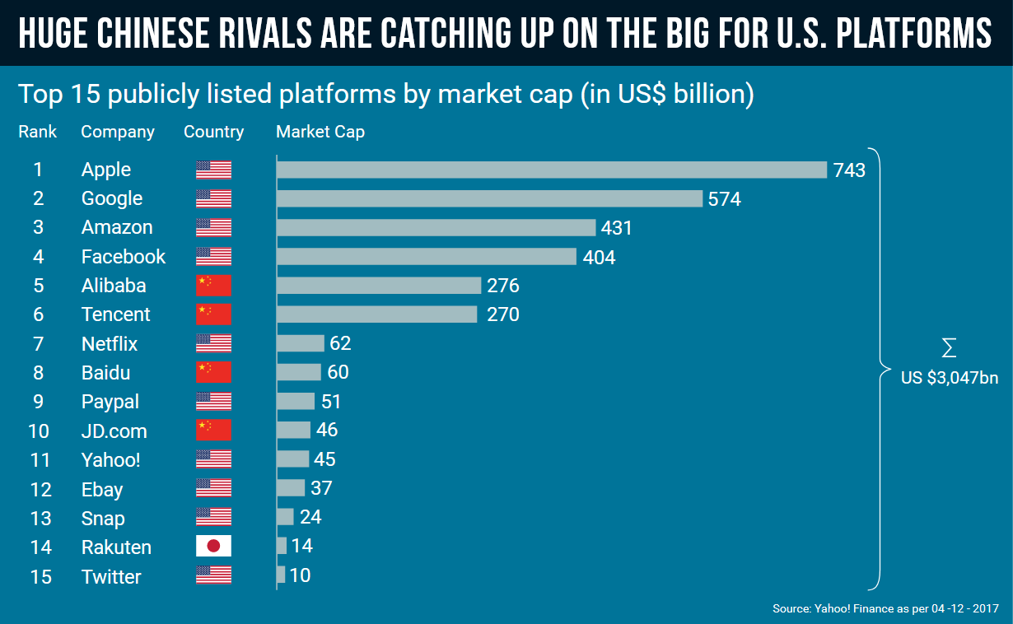
What about sellers outside the EU such as China ?

Slide 22
What about sellers outside the EU such as China ?
Sellers outside the EU do not abide by :
Warranty regulations.
European dispute resolution instruments.
Data protection (GDPR)
Social media companies such as Facebook do not abide by EU regulations and they have significant impact on eCommerce.
It is very difficult to seek redress on social media platforms such as Facebook.
#BetterDigitalWorld

Slide 23
Are Maltese business successful online ?
Numerous success stories.
Businesses inherently do not boast of their success because they fear increased competition.
Very limited cross border selling in Malta although over 100 companies are using Amazon.
Niche markets are the most successful.
Many times although the sale is not completed online, the decision is made online. (as evidenced by MCA research)
#BetterDigitalWorld

Slide 24
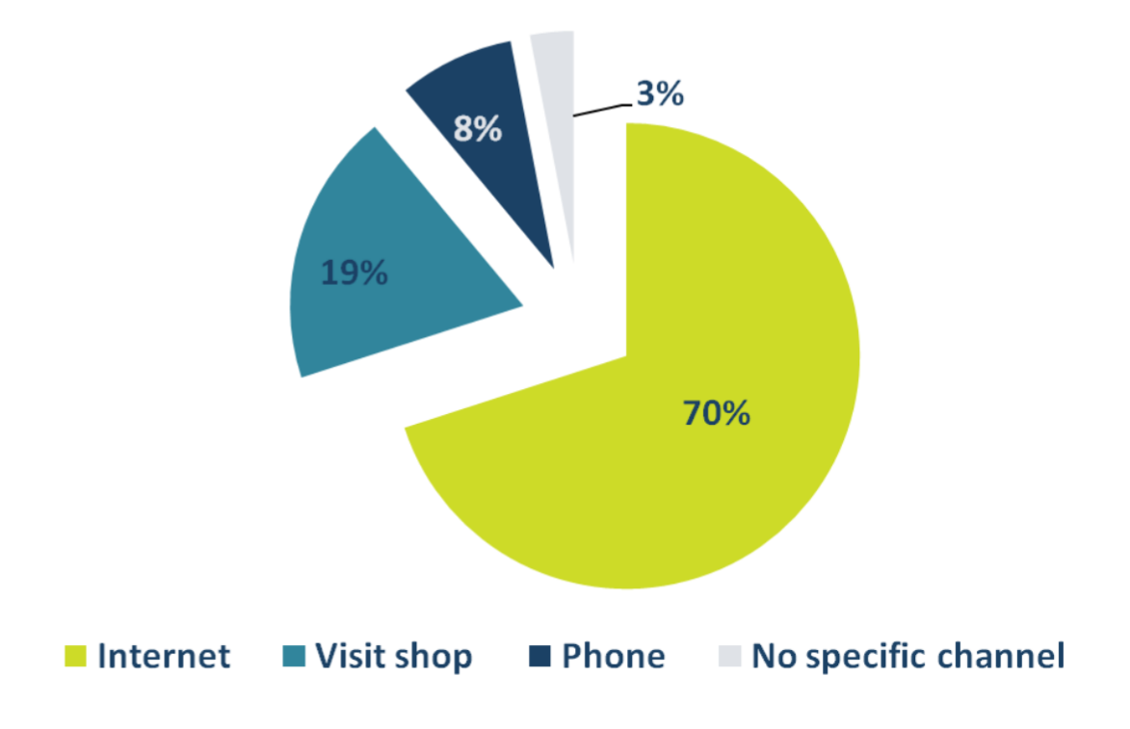
Pre-purchase habits in Malta (Source: MCA)

Slide 25
What is GRTU doing to encourage eCommerce ?
We represent online business in numerous EU forums. We are active in influencing EU policy.
We represent online businesses locally and regularly work with Government.
We participate in the design of schemes aimed at encouraging local business to sell online.
We hold regular information sessions for businesses.
We have published a book and an online multi-platform app to educate and encourage SMEs to go online.

Slide 27
Making the digital market fairer - Consumer’s perspective.
#BetterDigitalWorld

Slide 28
Making the digital market fairer – The consumer
Educate consumers to:
Use (and write) peer reviews to check the reputation of sellers and products.
Encourage users to select the safer payment options.
Encourage users to look for methods of redress BEFORE they make a purchase.
Teach consumers how to spot scams (Applies to businesses too).
#BetterDigitalWorld

Slide 29
Making the digital market fairer – The consumer
Educate consumers to :
Read terms and conditions carefully especially when buying from outside the EU.
Spot and report Geo Blocking.
Spot “Predatory Pricing”.
Know what to do when they encounter cyber crime.
Know what to do when they notice misleading advertising.
Be aware of dispute resolution instruments.
#BetterDigitalWorld

Slide 30
Making the digital market fairer – The consumer
Educate consumers to :
Retain all the details of a transaction.
Be aware that when buying from auction sites the site owner is not responsible.
Make sure that the seller has provided enough information about their business such as Address, contact email etc.
Read the terms to ensure that their personal data is secure.
#BetterDigitalWorld

Slide 31
Thank you
marcel.mizzi@grtu.eu
#BetterDigitalWorld

