Slide 1
Annual General Meeting Association for Consumer Rights, Malta Annual Report 2015
Saturday 12 March 2016
NCW Centre Blata l-Bajda
Grace Attard, General Secretary

Slide 2
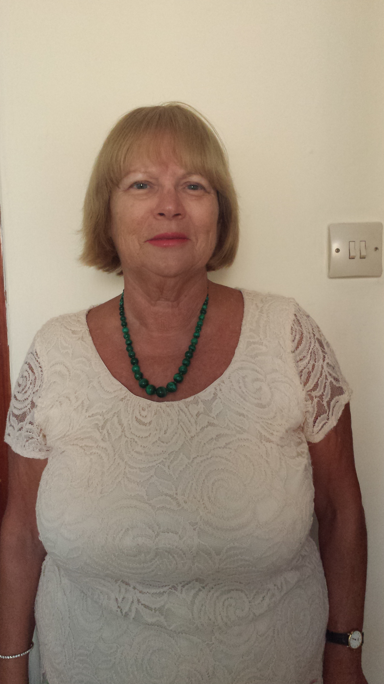
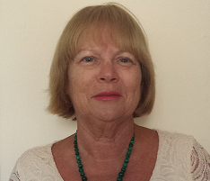
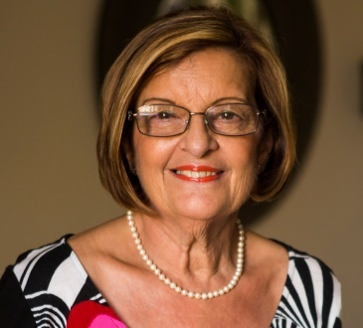
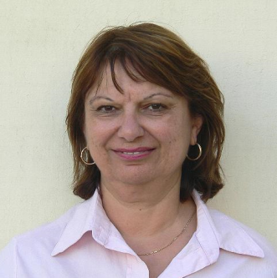
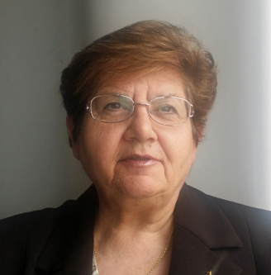
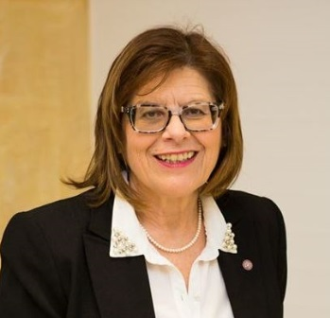
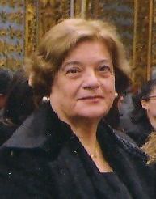
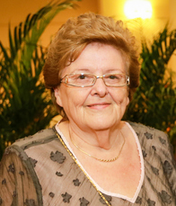
The Executive Committee 2015
President Mary Mangion
General Secretary Grace Attard
Hon Treasurer Pauline Azzopardi
Members Anna Dalli (Assistant Treasurer)
Barbara Buttigieg (Public Relations)
Marie Demicoli (Assistant Secretary)
Lina Caruana
Doris Bingley
Notes:
2

Slide 3
http://acrmalta.weebly.com/

Slide 4
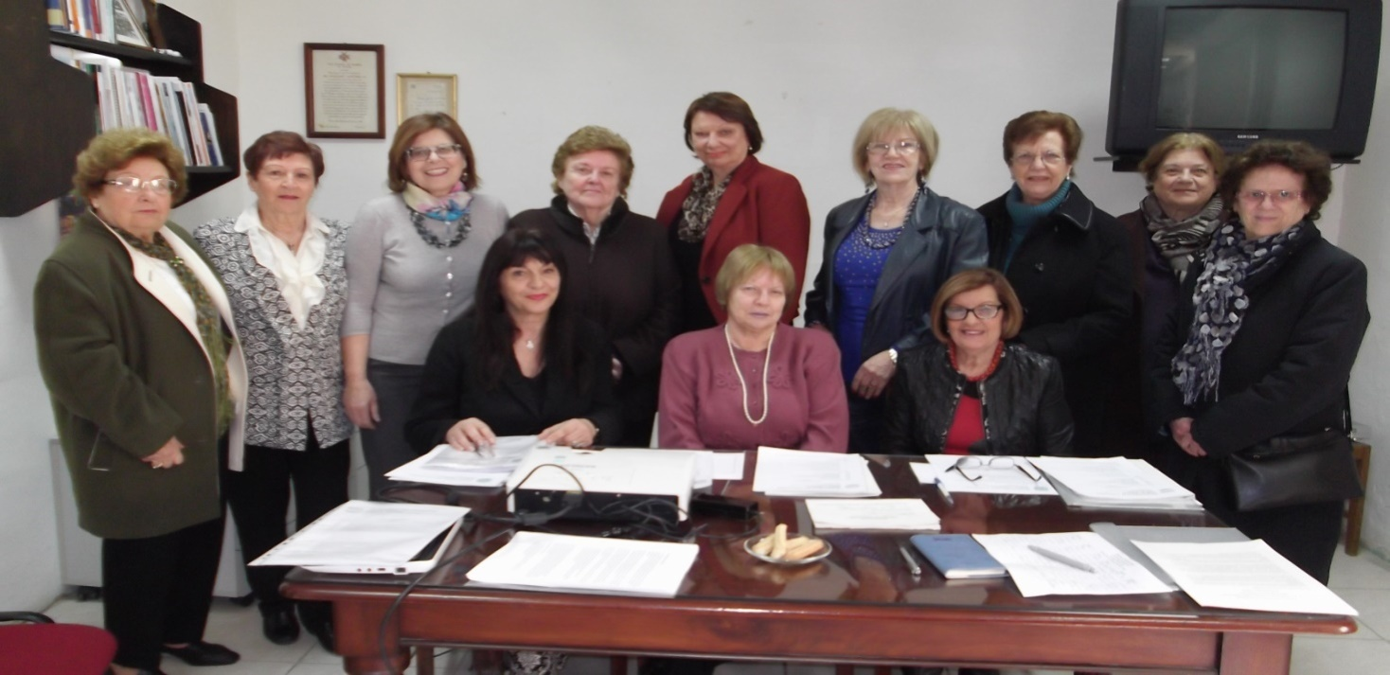
Executive Committee Meetings April 2015 - March 2016
The ACR Executive Committee met 9 times on a monthly basis between April 2015- March 2016.
We are very grateful to NCW for the services they are offering us, in particular the use of the NCW premises for the ACR meetings.

Slide 5
ACR Budget proposals and Pensions Reform 2016
Every year ACR carries out a study and through consultation with government and other stake holders makes proposals to the annual national budget to address the needs of various sectors of society in a holistic manner.
During 2015, government also issued a White Paper on Pensions Reform for consultation

Slide 6
Developing a Culture for Financial Savings and Retirement Income
Integrating young people in the Labour Market with particular focus on Early School Leavers and young people with disability, employment skills and entrepreneurship
Addressing the impact of new technology from a social and economic perspective
Financial Education and Responsible Consumption
Addressing Online Gambling
Measures to combat household over indebtedness
Notes:
6

Slide 7
Strengthening the Pensions System in Malta
Active participation of Elderly Persons: working beyond retirement age, addressing barriers for older people to work beyond retirement
Facilitating the transition of workers from the shadow economy: undeclared work, precarious work, care services to the family among others

Slide 8
The gender perspective
Addressing the situation of divorced or separated couples
Active labour market polices from a gender perspective
Crediting contributions for child rearing, care of elderly relatives for both men and women etc
Expanding Lifelong Learning Opportunities for all ages

Slide 9
Migration
ACR has proposed the following measures towards the setting up an Economic Migration Policy for Malta which will provide for the development of our economy rather than a burden on Maltese society
An integration policy, that includes education and training and social integration
Ensuring decent work
Addressing the employment needs of migrant women
Encouraging migrant entrepreneurship

Slide 10
ACR Press Releases
Discriminatory mobile charges for vulnerable groups
The need for transparency in fuel prices
Addressing public transport – an immediate priority
Prompt action to deal with the risk of bowel cancer from processed meat

Slide 11
ACR-NCW Project “The Reduction of Poverty through Personal and Social Development and Social Integration” December 2015- May 2016
NCW in collaboration with ACR are currently running three courses of six weeks in
personal and social development,
team work,
communication,
IT awareness and media skills,
labour market trends and job searching
financial education and responsible consumption,
Adminstrator: Marie Demicoli
Mentor and Trainers: Grace Attard, Vivien Cassar, Josette Barbara Cardona
MEA and ETC representatives
This project has received funding from MCCF
Notes:
11

Slide 12
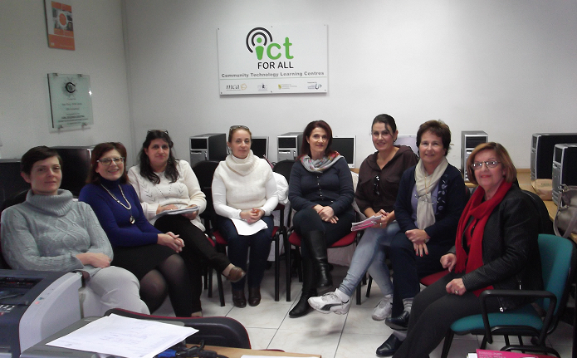
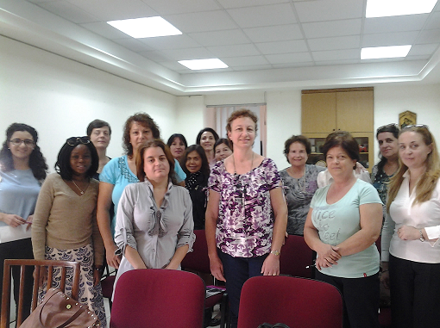
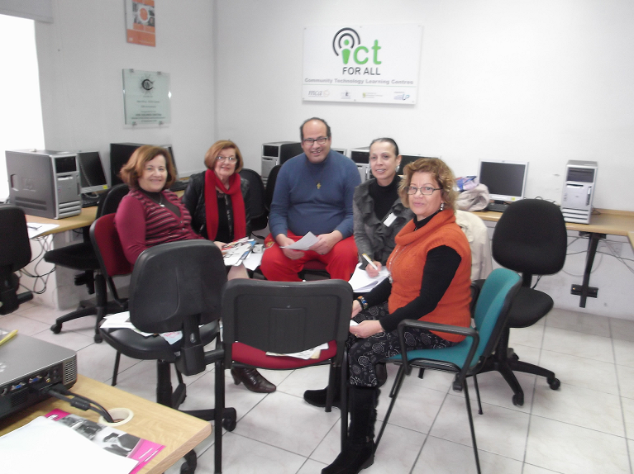

Slide 13
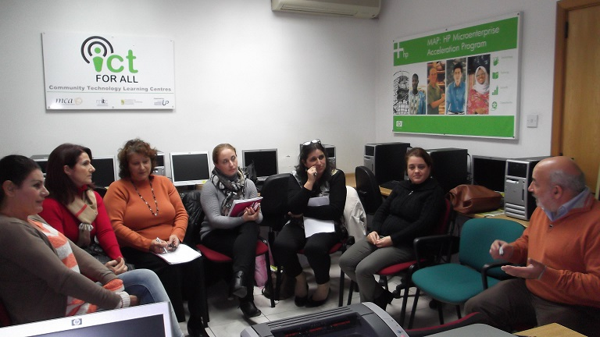
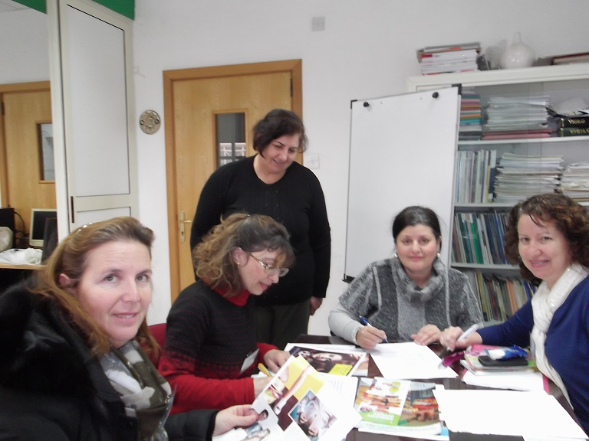
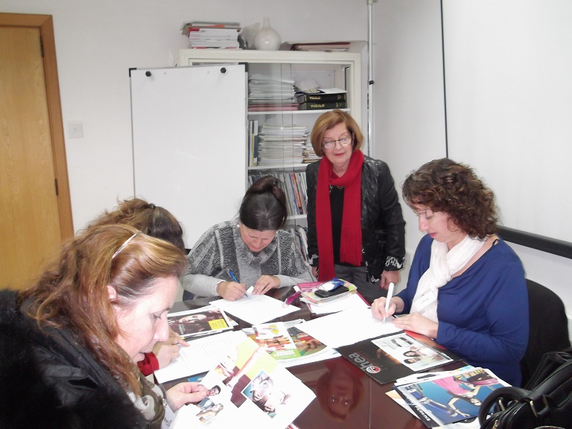

Slide 14
ACR Talks and Conferences

Slide 15
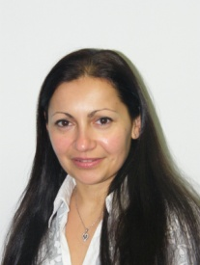
ACR Talk on “The Role of Market Surveillance vis-a-vis the placing of cosmetics on the Market” - 22 Oct 2015
“Market Surveillance on Cosmetics”
Speaker: MS Shirley Mifsud
BSc Hons, DipSM,
Market Surveillance Scientist,
Malta Competition and Consumer Affairs Authority, MCCAA

Slide 16
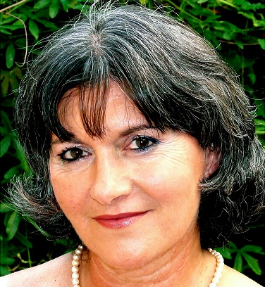
ACR Talk on “The Role of Market Surveillance vis-a-vis the placing of cosmetics on the Market” – 22 Oct 2015
“Beauty Therapy in Malta and Standardisation”
Speaker: Ms Magda Magri Naudi
President of the Malta Association of Beauty Therapists (MABT)
General Secretary of the European Confederation CEPEC;
Tutor and Internal Verifier VCTC

Slide 17
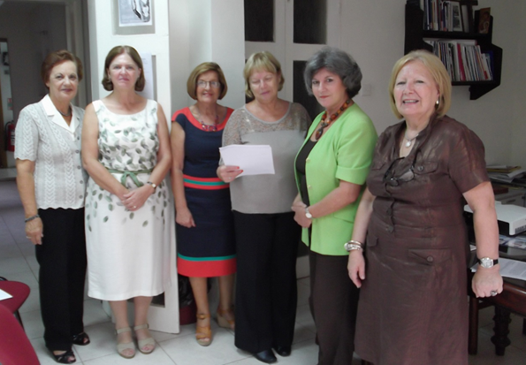
ACR Talk on “The Role of Market Surveillance vis-a-vis the placing of cosmetics on the Market” – 22 Oct 2015

Slide 18
Talk by ACR President - “An overview of ACR” – 13 Nov 2015
ACR President, Mary Mangion spoke about the role of ACR, followed by an explanation on the initiatives of the ACR
Audience: group of widows and widowers at the Oratorju Mosta.
About fifty people attended, women outnumbering the men but a good attendance still of the male gender.

Slide 19
‘The Future of Social Dialogue in the European Union’ a MEUSAC Meeting – 08 May 2015
Organised by MEUSAC and the Speaker of the House of Representatives at the new Parliament Building.
The European Commission Vice President responsible for the Euro and Social Dialogue, Valdis Dombrovskis addressed the participants.
Grace Attard (EESC Bureau Member) raised the following points:
Maltese citizens, like many European citizens, are currently detached from the EU
The importance of a social dialogue
Issues to be tackled: the creation of quality jobs, poverty and inequality
Digitalisation as the core solution for future jobs.
Research and development need adequate funding

Slide 20
Conference High Impact : Improve your Organisations’ Performance – 05 May 2015
Organised by Mr. Mark Weingard, Founder of Inspirasia Foundation and the
Malta Council for the Voluntary Sector
Conclusion of this conference is that for an NGO to be able to raise funds, it must speak on the same terms as the objective of the Company from which it is seeking support. However there should be mutual benefit.
Pauline Azzopardi and Lina Caruana participated

Slide 21
EU Questionnaire on contract rules for online purchases
DG Justice and Consumers of the European Commission launched an EU questionnaire on new contract rules for online purchases of digital content and tangible goods as part of a public consultation
Pauline Azzopardi distributed it to the Committee to take part in the public consultation.
This questionnaire was also placed on the ACR website

Slide 22
Participation in Conferences and Public Dialogues

Slide 23
Report on the Transatlantic Trading Partnership – TTIP consultation – 3 July 2015
ACR Executive Committee member, Lina Caruana actively participated in the Malta Business Bureau Consultation session.
Recommendations:
The Association for Consumer Rights can contribute to society by being a watchdog and urging governments to attend to the business structures and how they function based on actual basis of scientific information.
ACR can also make use of experts such as:
Profs Claude Farrugia, Chemistry Department, Uni of Malta on Pharmaceuticals.
Ivan Ebejer Officer at Ewropa House on EU Semester information.
A number of presentations of this session were sent to ACR

Slide 24
Participation in the Enterprise Consultative Council – 24 Sep 2015
ACR General Secretary contributed to the discussion on the EU-US Transatlantic Trade and Investment Partnership (TTIP) regarding the following points:-
Safeguarding the interests of civil society;
Addressing the situation of SMEs
Importance of not lowering existing EU standards in particular to farmers and agriculture;
GMOs and how these will change with the TTIP
Ensuring standards that guarantee safety measures for medicines and medical devices .

Slide 25
Launch of the Draft National Strategy for Retirement Income and Financial Literacy - 26 Jan 2016
The Ministry for the Family and Social Solidarity, the Ministry for Finance and the Ministry for Education and Employment tasked a working group to draft a
National Policy for Retirement Income and Financial Literacy
an action plan for the period 2016-2018
understanding the importance of planning for retirement is of significant importance.
a person has to be financially literate in savings and /or investments accrued across different life-events result in the financial rewards sought.
Notes:
25

Slide 26
Launch of the Draft National Strategy for Retirement Income and Financial Literacy - 26 Jan 2016
Draft National Strategy key messages:
Knowledge: A person who is better informed makes improved and reasoned decisions
Planning: If better informed one can plan for the present and the future
Action: A person who is knowledgeable is able to act to improve their and their family’s future financial well-being
As a follow-up, ACR Gen Secretary, Grace Attard and NCW President Mary Gaerty , held a meeting with Mr Spiteri Gingell Chair of the Task Force at NCW Centre

Slide 27
Conference ‘Living with Migration’ – 30 Oct 2015
Public Dialogue organised by the European Parliament Information Office, organised by Dr Peter Agius.
An Insight by Experts and Maltese MEPs
Eurostat survey findings that 83% of the Maltese population consider migration as the highest concern.
The Conference aimed at putting emphasis on the process after the arrival of migrants in Malta – integration
Notes:
27

Slide 28
MCCAA Award – “Servizz bi Tbissima” Project -10 Nov 2015
Presentation of prizes to companies who participated in ‘Servizz bi Tbissima’ project
ACR President Mary Mangion, Grace Attard , Marie Demicoli and Doris Bingley attended.
ACR member Marie Demicoli has been a member of this promotion committee for two consecutive years.

Slide 29
ACR Meeting with MCCAA Chair Mr Pizzuto - 12 Feb 2015
An ACR delegation (Mary Mangion President, Grace Attard, Pauline Azzopardi and Marie Demicoli ) held a meeting with Mr Pizzuto
Director Joyce Borg and experts Maria Stivala and Melanie Vella took part in the discussions
A number of issues were discussed :
literature of medicinal products in language that can be understood by Maltese consumers,
unfair practice regarding dates of guarantee obligations
lack of pricing on products,
duration of credit card vouchers when returning goods
prevention and reduction of food waste,
overindebtedness among others

Slide 30
Civil Society participation in meetings of the MCESD Core Group

Slide 31
Meeting of MCESD Core Group on Jobs – 29 April 2015
Points that were raised during the meeting
Investing in skills
Work Programme 2000 for the long term unemployed
Social Enterprise
Job Matching system
Youth Guarantee Scheme
Initiative for disabled
Maternity Fund
Making Work Pay Scheme

Slide 32
MCESD Civil Society Public Hearing “Moving towards a more effective Social and Civil Dialogue” 20-21 October 2015
Recommendations
Addressing the lack of ‘representation’ in the MCESD CS
The need for feedback from authorities
Receiving on time the agenda and topics to be discussed by the MCESD so that CS members can prepare comments/recommendations
As in the EESC, Civil Society should be on equal level with Employers representatives and Trade Unions. This requires changes in national legislation

Slide 33
MCESD Civil Society appointment for 2016-2018
ACR President, Mary Mangion and Assistant Secretary Marie Demicoli have been appointed representative and substitute respectively of the Consumers Sector on the MCESD Civil Society Committee.
ACR is now in a better position to promote consumer rights and consumer protection through the MCESD

Slide 34
MEUSAC Core Group meetings
ACR Hon Treasurer Pauline Azzopardi was one of the three Civil Society members elected on the MCESD Core Group for 2013-2015
She participated in a number of consultation meetings

Slide 35
Preparations for Maltese European Council Presidency 2017
MEUSAC Core Group
Meeting with Hon Dr Ian Borg, Parliamentary Secretary
Preparations for the 2017 Malta Presidency were outlined.
Members of the MEUSAC Core group submitted their priorities to be dealt with during the Malta Presidency
EESC Board Member Grace Attard and the Maltese members of the EESC delegation
Meetings with Parliamentary Secretary Hon Ian Borg and CEO Victor Camilleri in Malta and at Dar Malta in Brussels with the EESC members to discuss logistics.
Grace Attard was invited by the Parliamentary Secretary to collect the priorities of the Civil Society actors which were then submitted to Hon Ian Borg and CEO Victor Camilleri

Slide 36
MEUSAC Core Group Meeting with EU Commissioner Karmenu Vella - 30 Jan 2015
ACR representative Pauline Azzopardi participated
Recommendations and proposals on the following themes were presented:
Innovation in the Blue Economy
Growth and Jobs in Coastal and Maritime Tourism
Maritime Surveillance
Sustainable Development
Plastic Waste Management

Slide 37
Meeting of the EESC Consumers and Environment Category - work programme for 2016
Suggested topics:
the agreement on the TTIP: in addition to chemical substances, the problem of their uses and of the use of digital data;
digital agenda: consumer rights in the digital domain; non-material content; digital issues, in particular for older people;
effect of the media on civil society in relation to terrorism;
energy from the point of view of consumers (energy transition) - in collaboration with the SDGs;
use of chemicals (REACH);

Slide 38
European Consumers Day 2016, 18th Edition, 10 March 2016, Brussels
The Conference focused on the Better Regulation initiative
The role of the Commission and other institutions in implementing this new strategy
To make sure that consumers benefit from the proposed regulation.
The discussion also dealt with the role of public consultation and which aspects of the regulation need to be improved

Slide 39
European Consumers Commission Group (ECCG)
Reports by ACR Representative
Pauline Azzopardi

Slide 40
Conference “Shaping the Consumer Policy of the Future” 1-2 June 2015
The themes of the Conference
“Shaping the Consumer Policy of the Future” and the
“Workshop on the Revision of the Unfair Commercial Practices Directive Guidance documents”.
ACR Financial Secretary, Pauline Azzopardi is the alternate representative on the ECCG.
ACR alternate Pauline Azzopardi was able to attend in June 2015 in the absence of Dr A. Grima (the Malta representative)

Slide 41
Annual Report by Members of the ECCG representatives of Consumer NGOs
A report was sent to the European Commission Health and Consumers Directorate – General with comments from different consumer organisations
Information was sent by Pauline Azzopardi, ECCG alternate member on issues that have affected the consumer in Malta.
Consultation with different consumer organizations
The weak protection afforded in Malta to consumers via redress and the need for more awareness of their rights
the lack of funds to support NGOs were also highlighted in the report

Slide 42
New data dissemination tool for statistical information – 15 Jan 2015
A new data dissemination tool for consumer evidence is now available at the Consumer Scoreboards webpage http://ec.europa.eu/consumers/consumer_evidence/consumer_scoreboards/index_en.htm.
The database has a user-friendly, interactive interface that allows the public to generate customised reports and save queries in spreadsheet format.
It is designed both for stakeholders and the broader public.
Comments or queries can be sent on JUST-CONSULT-E1@ec.europa.eu

Slide 43
New data dissemination tool for statistical information – 15 Jan 2015
The scoreboard on best performances in Malta does not reflect the real situation in many areas such as banking services and fees, maintenance services, pension products and property agencies services where in all case the charges are much higher than in outer EU Member States.
From: JUST-RAPEX@ec.europa.eu - 23 March 2015

Slide 44
Consumer market study on the functioning of legal and commercial guarantees for consumers in the EU
Across the EU28, 50% of consumers consider that, in general, sellers in their country inform consumers about the legal guarantee period for products.
Among in-store mystery shoppers 42% found information displayed with the product and/or were spontaneously informed by a sales person that the legal guarantee is free of charge and for a minimum period of two years.
Across all EU countries, consumers had a good understanding of the legal guarantee coverage; between 72% of consumers in Cyprus and 97% in Slovenia

Slide 45
Consumer market study on the functioning of legal and commercial guarantees for consumers in the EU
However, only about half as many consumers (35%) were aware of the legal guarantee period in their country (2 years except for the longer periods in the UK and Sweden).
When asked whether, in general, information provided by sellers about the legal guarantee was clear, transparent and not misleading, only 50% of consumers in the EU agreed with this proposition.

Slide 46
Online platform for alternative dispute resolution
This platform was created in line with the framework of Regulation (EU) No 524/2013 (Regulation on consumer ODR).
It is now open to the public consumers who make purchases online and who end up with a complaint with the supplier.
The online purchase can be made in the same member state of the consumer and http://ec.europa.eu/odr trader or else the consumer and trader are in different member states.
The platform will allow consumers and traders to settle their online disputes both for domestic and cross-border purchases, without the need to go through lengthy and costly court proceedings.

Slide 47
Online platform for alternative dispute resolution
This online platform will also strengthen trust in online purchases and thereby make an important contribution to the EU's Digital Single Market strategy.
When consumers and traders lodge a complaint, the dispute resolution bodies will act as a referee between the two parties to resolve the issue.
National Contacts:
356 21 221901 356 or 21 221902
odrmalta@mccaa.org.mt

Slide 48
ANEC European Consumer Standardisation Agency, Brussels
European consumer voice in standardization and defends consumer interests in the process of standardization and certification.
The Steering Committee has decision-making roles which gives its members the opportunity to address emerging issues besides dealing with best practices to improve standards where necessary and in conjunction with other EU organizations working on consumer affairs

Slide 49
ANEC European Consumer Standardisation Agency, Brussels
At the ANEC AGM in mid 2012, General Secretary, Grace Attard on behalf of ACR was appointed member of ANEC (2012-2015).
At the ANEC AGM 2015, Grace Attard was elected member of the Steering Committee (2015-2017).
ACR Public Relations Officer, Barbara Buttigieg, who has a lot of experience as MCCAA Director, has been selected for the post of expert on the working group responsible for domestic appliances from Malta.

Slide 50
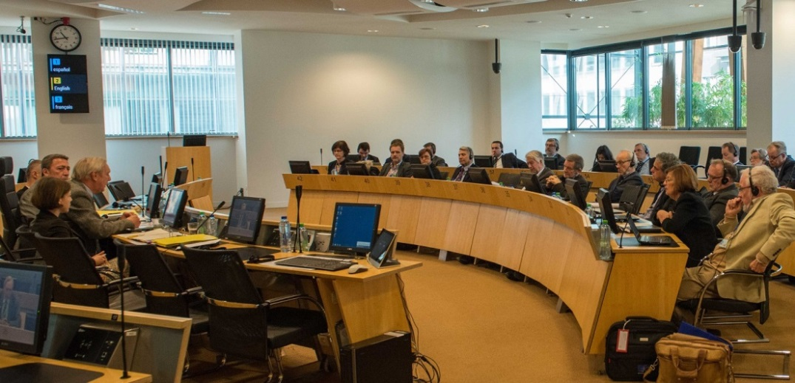
Appointment of Delegate on the EESC Consultative Committee on Industrial Change (CCMI)
During the EESC Plenary Session, January 2016 , Grace Attard was appointed as Delegate to ANEC on the CCMI Committee.
In her role she will ensure that:
standards in industry respect the needs of consumers and
there is balance between consumers and industry in policies and practices as reflected in ANEC position papers.
The first CCMI topic she will be working on is “European personal care, body hygiene and beauty products industrial sector".

Slide 51
ANEC Strategy 2014 to 2020
Areas to be addressed :
Consumer Product Safety Regulation
European Accessibility Act
Cross border consumer services complaints data
Chemicals in consumer products
Market Surveillance Regulations
European Injury Database
Transatlantic Trade and Investment Partnership (TTIP)

Slide 52
ANEC recommendations on Toys - lower limits for chemical compounds
ANEC welcomed the positive opinion of the EC’s Toy Safety Committee on 8 June to include
new limit values in Appendix C of the Toy Safety Directive for formamide and the sensitizers, CMI, MI, CMI/MI 3:1 and BIT.
the new values were established by the EC’s Subgroup on Chemicals in Toys.
The Subgroup was created in 2010
in answer to a request of ANEC and several Member States
to make proposals for improving the chemical requirements of the Toy Safety Directive.
VIDEO: http://www.tietoy.org/home/

Slide 53
Malta European Council Presidency 2017 - Meeting with Mr Victor Camilleri – 14 April 2015
Aim: to discuss priorities of Civil Society of the Malta EU Council Presidency 2017
Mary Mangion and Grace Attard discussed ACR proposals together with a number of MCESD CS members present;
This was a follow-up of the intiative taken by Grace Attard as EESC member who had already submitted a number of proposals from different NGOs in February 2015.

Slide 54
Meeting of MCESD with EESC representatives
The five members of the EESC, Stephano Mallia, Charles Vella, Anna Maria Darmanin Grace Attard and Vince Farrugia were invited by the MCESD to make a presentation on their work in the EESC.
The representatives of MCESD highly praised the work carried out by the five representatives.
A number of topics of importance to Malta discussed were
Taxation, State Aid, Consumer Protection and consumption, Products imported from non-EU countries and unfair market practices

Slide 55
ACR programme for 2016
The program for 2016 will continue working on reaffirmation of resolutions 2015 that require further attention.
These include:
Online gambling: principles to ensure effective protection of consumers
Household Over-indebtedness
Financial Education and Responsible Consumption
Strategy for the Prevention and Reduction of Food Waste

Slide 56
ACR plan for 2016
ACR will increase its ‘market watch” (market surveillance) especially with your contribution in informing us of unfair practices.
ACR will give priority to information for consumers through increasing events such as talks and discussions on current as well as emerging issues.
ACR will work on Resolutions for today’s AGM (2016)

Slide 57
Topics of complaints received by the Association
The Association regularly receives a number of queries and complaints on various products and services..
Topics of complaints that we receive, often by phone range from
white goods,
technology devices,
clothing,
issues concerning guarantees,
better safety measures in products and services and
online shopping information.
We thank Assistant Secretary Marie Demicoli for her valid contribution in answering complaints over the phone and passing them on to us or to the MCCAA

Slide 58
Conclusion
I am grateful to all Executive Committee members whose commitment to the Association has been crucial to the development of our initiatives.
Their participation in various talks and seminars, the information they provide us from time to time is very important for us to keep in touch with emerging needs of consumers, as well as the public relations initiatives that give ACR visibility are all crucial to our work.
We are continually building contacts with organizations at EU level, ensuring that we are in decision-making positions to be able to influence measures that safeguard the rights of consumers.

Slide 59
Thank you Grace Attard, General Secretary, Association for Consumer Rights Malta (ACR)

